Slide 1
AZ-220T01: Microsoft Azure IoT developer

Slide 2
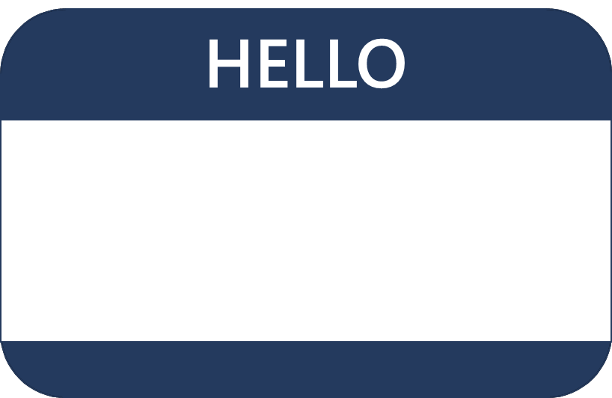
Hello! Instructor introduction
Instructor: <Name>
<Title or other credentials, e.g., Microsoft Certified Trainer>
<Affiliation/Company>
<A few words about my technical and professional experience>
Me

Slide 3
Hello! Student introduction
Let’s get acquainted:
Your name
Company affiliation
Title/function
Microsoft Azure experience
Your expectations for the course
You

Slide 4
Facilities
Class hours
Smoking
Building hours
Internet access
Parking
Recycling
Restrooms
Emergency procedures
Meals

Slide 5
Course agenda
Module 1:
Introduction to IoT and Azure IoT Services
Module 2:
Devices and Device Communication
Module 3:
Device Provisioning at Scale
Lesson 1 – Introduction to IoT Solution Architecture
Lesson 1 – IoT Hub and Devices
Lesson 1 – Device Provisioning Service Terms and Concepts
Lesson 2 – IoT Hardware and Cloud Services
Lesson 2 – IoT Developer Tools
Lesson 2 – Configure and Manage the Device Provisioning Service
Lesson 3 – Lab Scenarios for this Course
Lesson 3 – Device Configuration and Communication
Lesson 3 – Device Provisioning Tasks

Slide 6
Course agenda
Module 4:
Message Processing and Analytics
Module 5:
Insights and Business Integration
Module 6:
Azure IoT Edge Deployment Process
Lesson 1 – Messages and Message Processing
Lesson 1 – Business Integration for IoT Solutions
Lesson 1 – Introduction to Azure IoT Edge
Lesson 2 – Data Storage Options
Lesson 2 – Data Visualization with Time Series Insights
Lesson 2 – Edge Deployment Process
Lesson 3 – Azure Stream Analytics
Lesson 3 – Data Visualization with Power BI
Lesson 3 – Edge Gateway Devices

Slide 7
Course agenda
Module 7:
Azure IoT Edge Modules and Containers
Module 8:
Device Management
Module 9:
Solution Testing, Diagnostics, and Logging
Lesson 1 – Develop Custom Edge Modules
Lesson 1 – Introduction to IoT Device Management
Lesson 1 – Monitoring and Logging
Lesson 2 – Offline and Local Storage
Lesson 2 – Manage IoT and IoT Edge Devices
Lesson 2 – Troubleshooting
Lesson 3 – Device Management at Scale

Slide 8
Course agenda
Module 10:
Azure Security Center and IoT Security Considerations
Module 11:
Develop with Azure Digital Twins
Module 12:
Build an IoT Solution with IoT Central
Lesson 1 – Security Fundamentals for IoT Solutions
Lesson 1 – Introduction to Azure Digital Twins
Lesson 1 – Introduction to IoT Central
Lesson 2 – Introduction to Azure Defender for IoT
Lesson 2 – Introduction to ADT solution development
Lesson 2 – Create and Manage Device Templates
Lesson 3 – Enhance Protection with Azure Defender for IoT
Lesson 3 – Monitor and troubleshoot ADT
Lesson 3 – Manage Devices in Azure IoT Central

Slide 9
Course description
This course provides students with the skills and knowledge required to successfully create and maintain the cloud and edge portions of an Azure IoT solution. The course includes full coverage of the core Azure IoT services such as IoT Hub, Device Provisioning Services, Azure Stream Analytics, Time Series Insights, and more. In addition to the focus on Azure PaaS services, the course includes sections on IoT Edge, device management, monitoring and troubleshooting, security concerns, Azure Digital Twins, and Azure IoT Central
The course material includes a combination of instructor-led presentation and discussion along with hands-on lab activities

Slide 10
Audience
The course is intended for solution developers/engineers who are or will be responsible for implementing an IoT solution using Azure IoT services
It would also be suitable for cloud solution architects who are interested in honing their implementation skills with the latest technologies
Notes:
“We are not trying to teach you everything a device programmer may know or to be a firmware engineer; for example, the course does not discuss how to program a flash chip on an IoT device…”
Note that the targets here are leaf devices, edge devices, and cloud services, meaning that sensors are out of scope.

Slide 11
Prerequisites
Prerequisites for taking this course are:
Software Development Experience: Software development experience is a prerequisite for this course, but no specific software language is required, and the experience does not need to be at a professional level
Data Processing Experience: General understanding of data storage and data processing is recommended but not required
Cloud Solution Awareness: Students should have a basic understanding of PaaS, SaaS, and IaaS implementations. Microsoft Azure Fundamentals (AZ – 900), or equivalent skills, is recommended

Slide 12
Certification areas (AZ-220)
Study Areas | Weights
Set up the IoT Solution Infrastructure | 10-15 %
Provision and Manage Devices | 15-20 %
Implement IoT Edge | 15-20 %
Implement Business Integration | 5-10 %
Process and Manage Data | 15-20 %
Monitor, Troubleshoot, and Optimize IoT Solutions | 15-20 %
Implement Security | 10-15 %
This course is aligned with the exam AZ-220 Microsoft Azure IoT Developer
Percentages indicate the relative weight of each area on the exam
The higher the percentage, the more questions you are likely to see in that area
Notes:
AZ-220 Certification Areas - https://docs.microsoft.com/en-us/learn/certifications/exams/az-220

Slide 13
Hands-on components
There are hands-on labs associated with each module in this course
The labs in this course are solution-based, meaning that they logically progress and build upon each other. Lab setup scripts are provided for most labs and are used to configure lab requirements in Azure.
Notes:
Labs can be found at the course GitHub site:
https://aka.ms/az220labs

